Slide 1
Lead Scoring

Slide 2
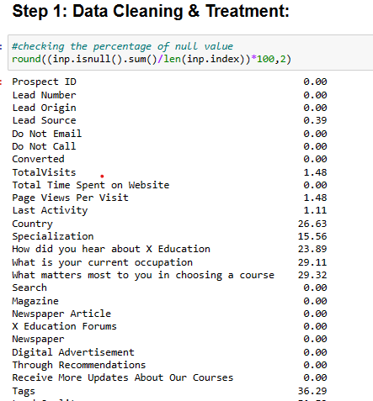
EDA
Checked for null values and dropped columns with more than 30% missing values.
Removed rows with null values, as they contained important columns and would result in a loss of a significant amount of data.
Conducted categorical attribute analysis and dropped a column based on the most common occurrence of certain words.
Worked on categorical variables, including creating dummy variables and handling outliers.

Slide 3
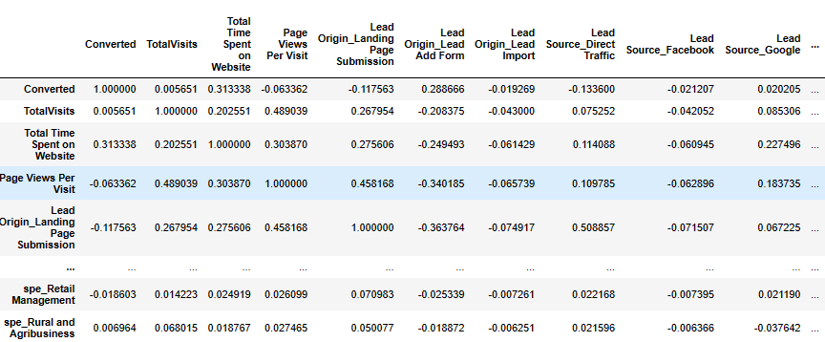
Train-Test split & Scaling
Split the data into a training set (70%) and a test set (30%)
Applied min-max scaling to the variables ['Total Visits', 'Page Views Per Visit, 'Total Time Spent on Website']
Model Building
Used recursive feature elimination (RFE) to select the top 15 relevant variables.
Removed variables manually based on their variance inflation factor (VIF) values and p-values.

Slide 4
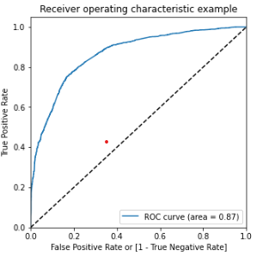
Model Evaluation
When evaluating the model on the training data using sensitivity-specificity, the optimum cutoff value was found using the receiver operating characteristic (ROC) curve to be 0.42, resulting in an accuracy of 78.10%, sensitivity of 73.98%, and specificity of 83.86%.
When evaluating the model on the test data using sensitivity-specificity, the accuracy was 78.66%, sensitivity was 78.15%, and specificity was 76.96%.
When evaluating the model on the training data using precision-recall, the optimum cutoff value was found to be 0.44, resulting in an accuracy of 78.99%, precision of 78.73%, and recall of 79.23%.
When evaluating the model on the test data using precision-recall, the accuracy was 79.17%, precision was 78.85%, and recall was 77.57%.

Slide 5
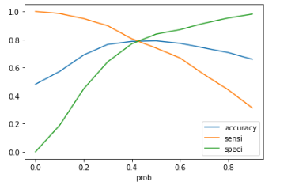
Graph shows the Accuracy, Sensitivity , Specificity

Slide 6
CONCLUSION
TOP VARIABLE CONTRIBUTING TO CONVERSION:
Total Time Spent on Website
Lead Origin_Lead Add Form
Lead Source_Olark Chat
Lead Source_Welingak Website
Do Not Email_Yes
Last Activity_Had a Phone Conversation
Last Activity_SMS Sent
What is your current occupation_Student
What is your current occupation_Unemployed
Last Notable Activity_Modified
The Model seems to predict the Conversion Rate very well and we should be able to give the Company confidence in making good calls based on this model.

Slide 7
THANK YOU

